Slide 1


Variational Neural-Network Ansatz for Steady States in Open Quantum Systems
Journal Club
Qian, Qingyun
Function Hub AMAT Thrust

Slide 2
Content
01
Why?
Why？
Why？
02
N-N
Ansatz
04
Conclusion & forward
03
Quantum
Monte
Carlo
05

Slide 3
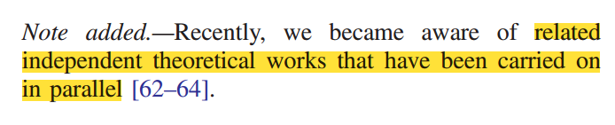
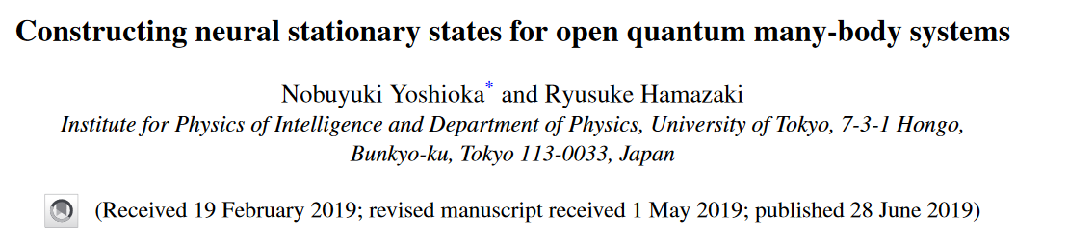
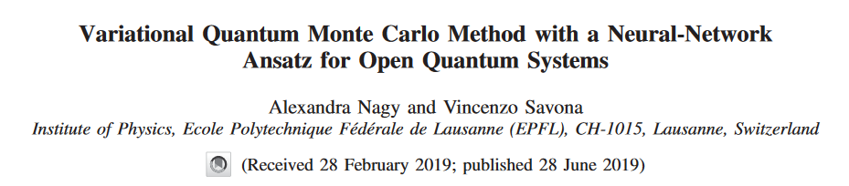
01
Why^3?
Motivation!

Slide 4
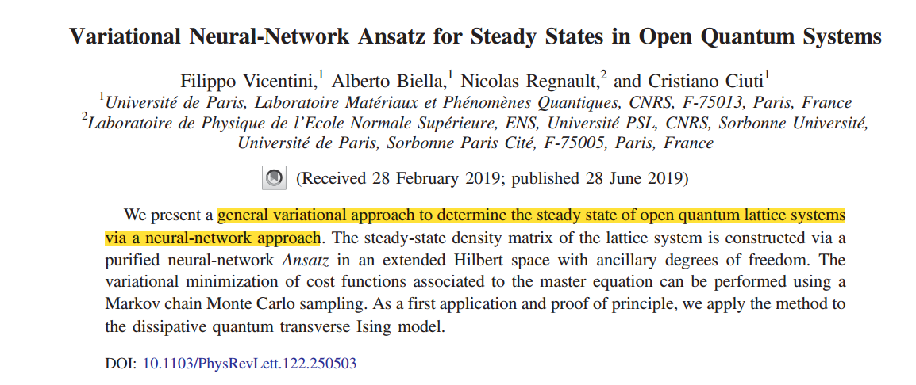
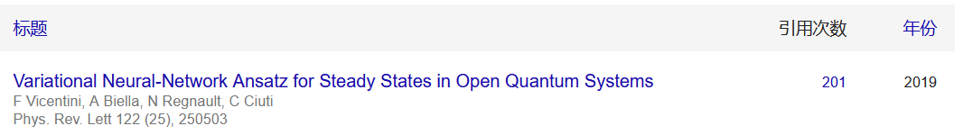
Why this paper?
A concise summary
A direct introduction to the main topic
A five-page length
Influential conclusions

Slide 5
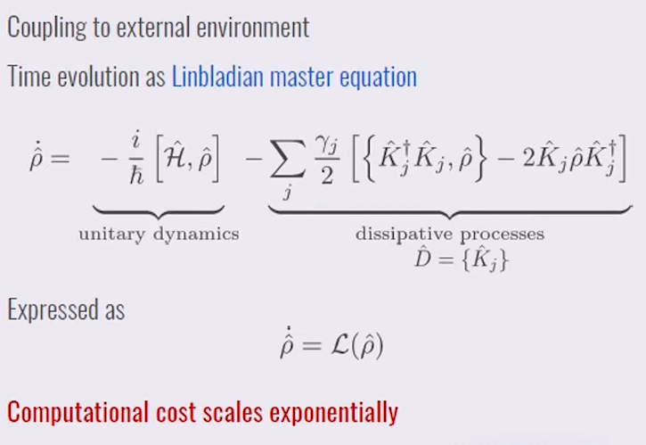
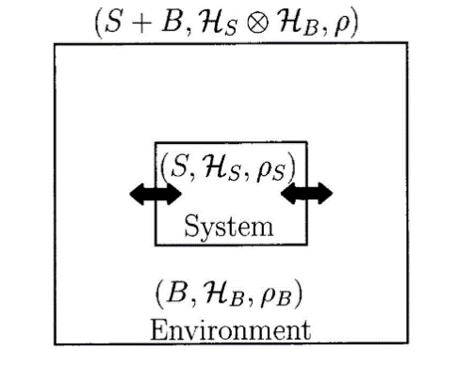
Why Open Quantum Systems?
More close to the real world
Exploration of Quantum Entanglement and Correlations
Exploration of Complex Quantum Dynamics

Slide 6
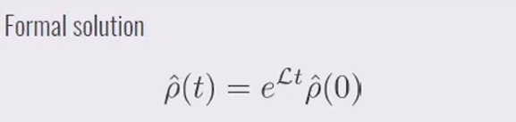
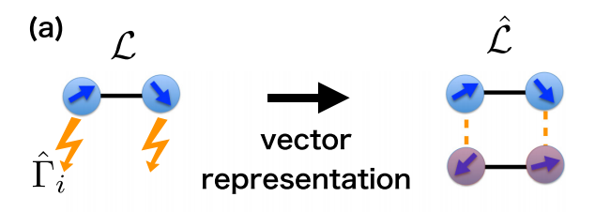
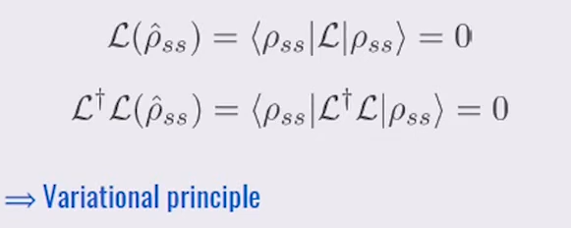
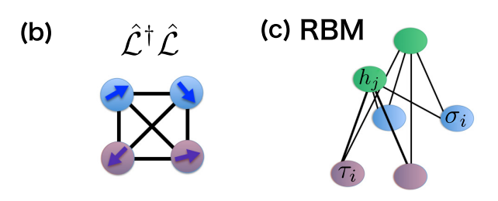
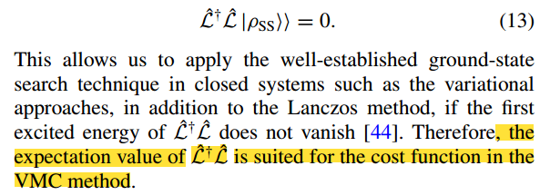
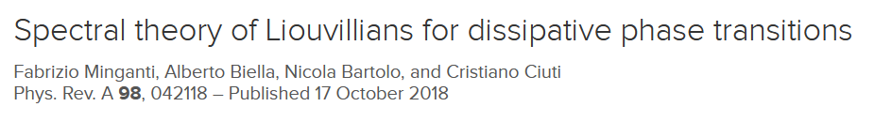
Stationary State
Existence of stationary state：

Slide 7
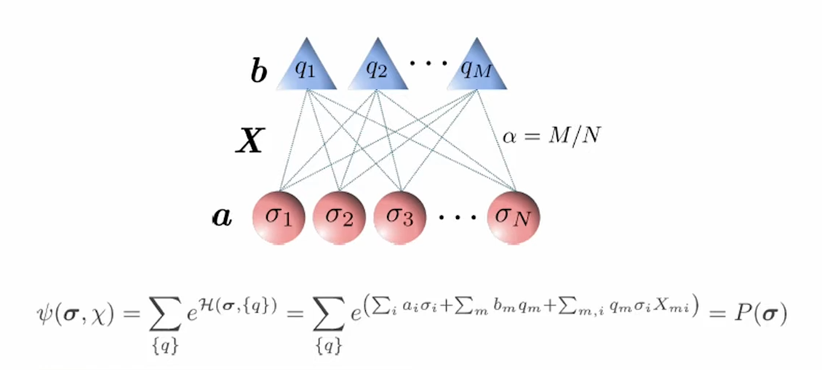
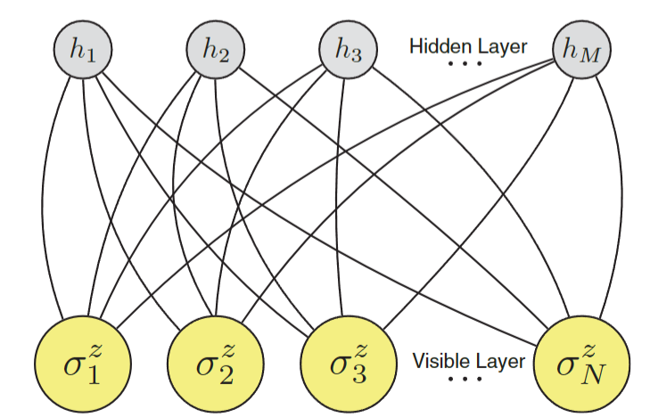
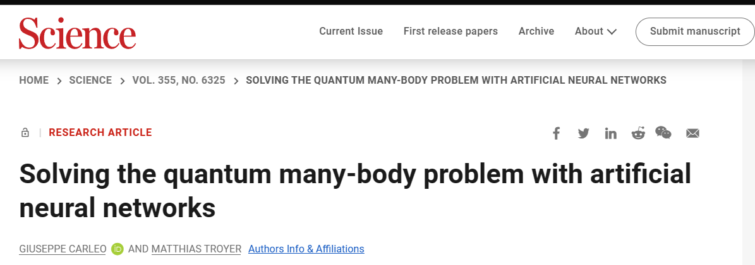
Why N-N? Restricted Boltzmann Machine（RBM）
RBM can effectively represent quantum states with large entanglement entropy
Complete &has strong expressive power
Be possible to circumvent the 'exponential wall' difficulty
No dimensionality constraint

Slide 8

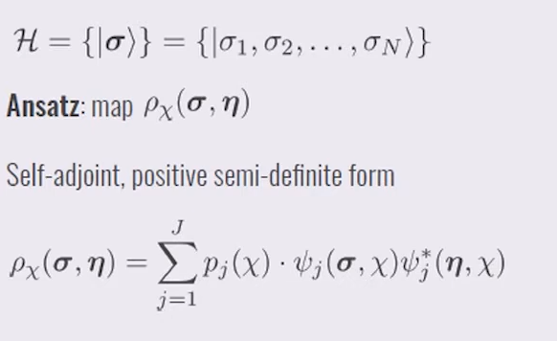
02
Variational Ansatz for the density matrix

Slide 9
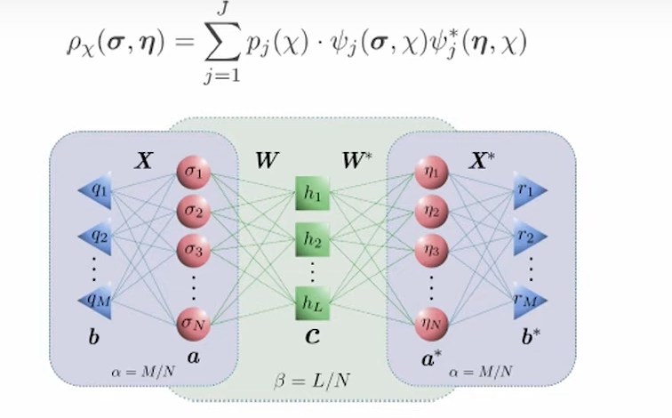
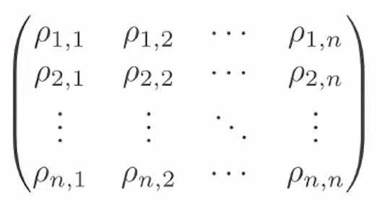
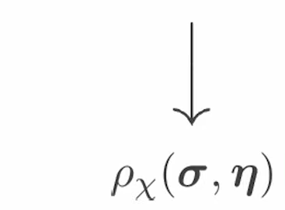
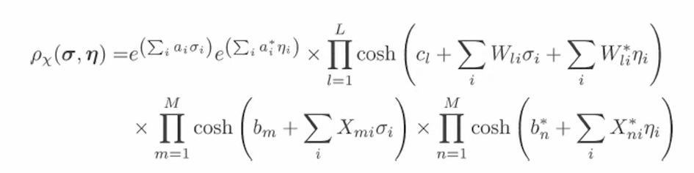
Ansatz
Accuracy：only depends on hidden layer nodes
How to optimize？

Slide 10
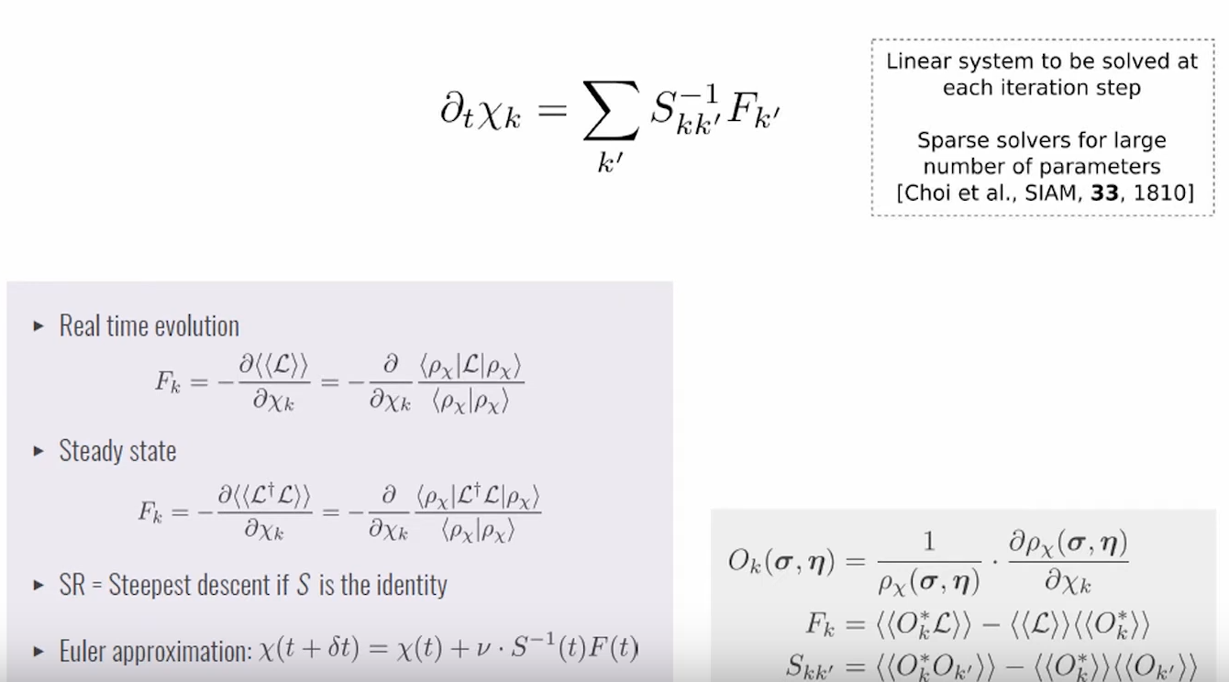
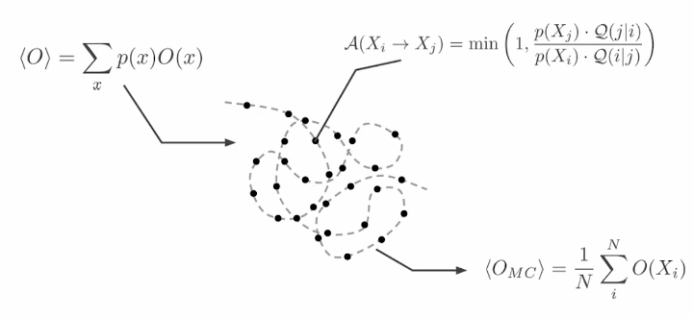
Stochastic sampling
Metropolis Hastings（MCMC）
Notes:
The origin of this noise is understood to arise from the stochastic flipping of spins (magnetic dipoles) that reside on the
surfaces of the superconducting metals comprising the qubit, resulting in random fluctuations of the effective magnetic field that biases flux-tunable qubits.

Slide 11
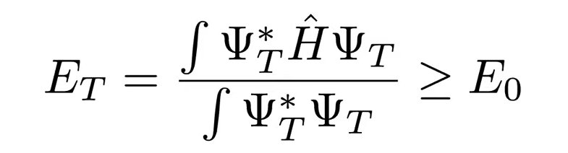
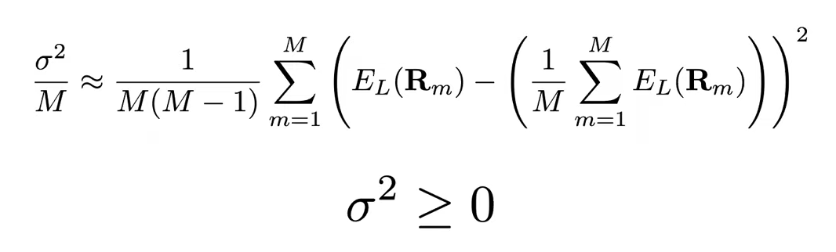
03
Quantum
Monte
Carlo(QMC)

Slide 12
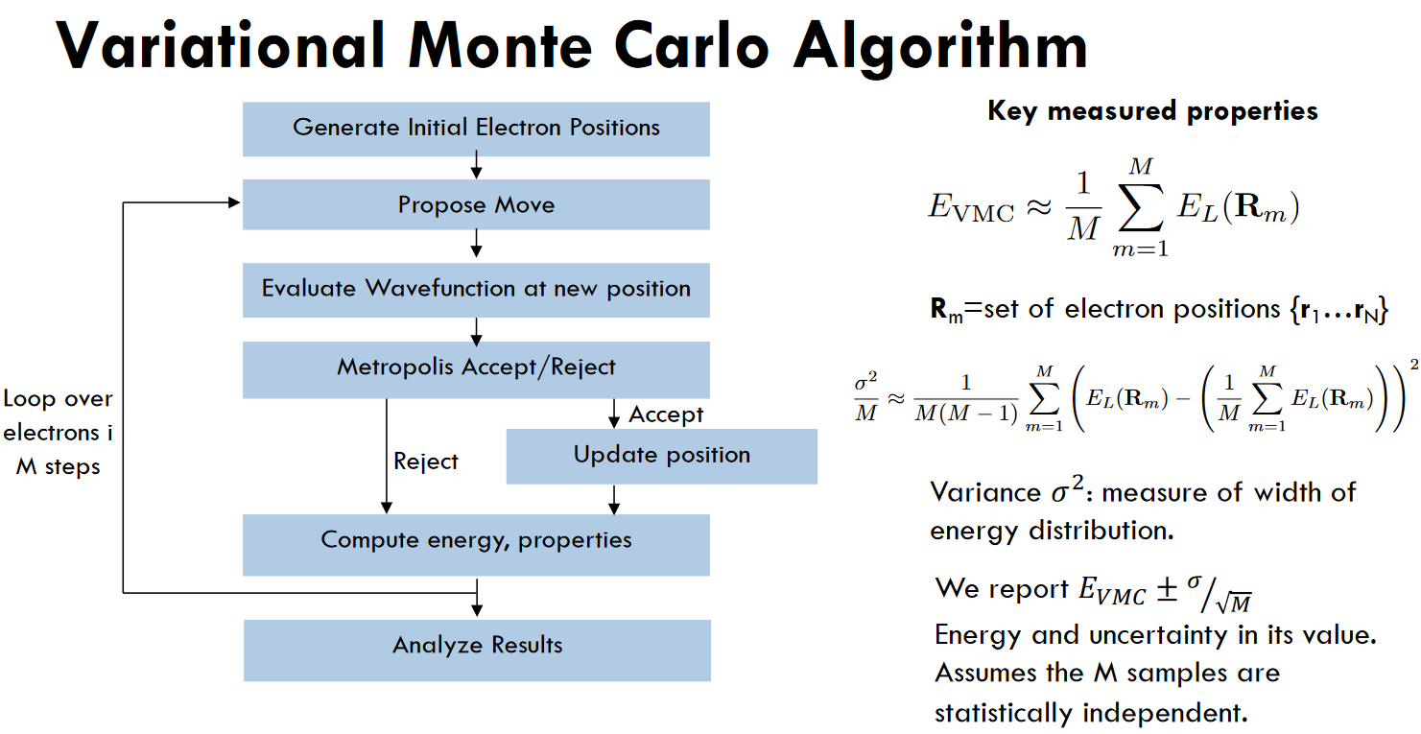
Monte Carlo
VMC
PIMC
DMC
And so on…
VMC:The trail wave function ansatz is the key

Slide 13
04
Conclusion &
Forward

Slide 14
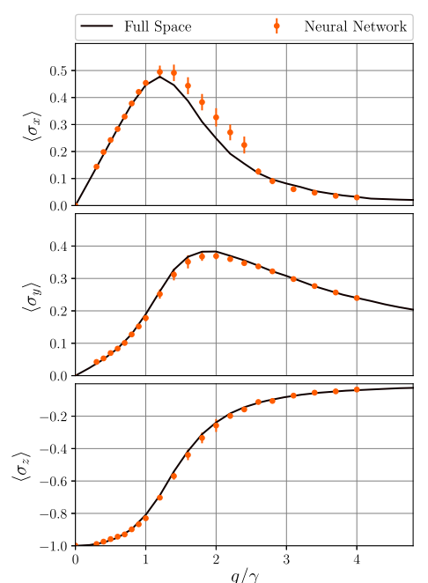
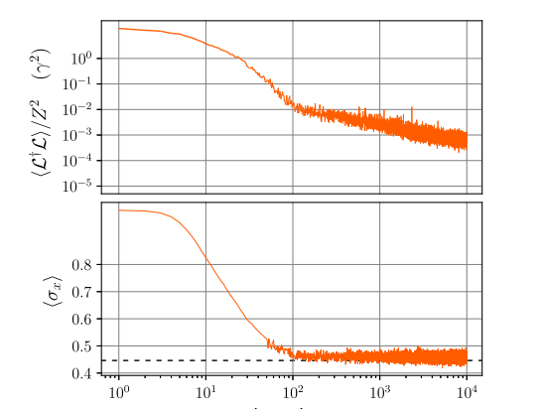
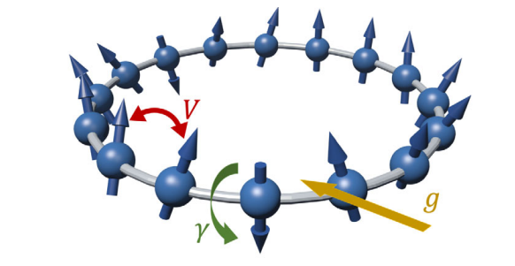
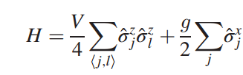
Monte Carlo
Transverse Ising Model

Slide 15
Conclusion
Advantages
Complete& has strong expressive power
Powerful method since you can use any trial function
Be possible to circumvent the 'exponential wall' difficulty
Bridge to ML DL
Disadvantages
Killer-level should not have been found yet
Black Box&Do not know how accuracy it is
Time-consuming

Slide 16
Thank you
Q&A

